Slide 1
Applied Statistical Analysis
EDUC 6050
Week 2
Finding clarity using data

Slide 2
Today
Working with Data
Overview of Statistics
Intro to Statistical Terminology
Intro to Jamovi

Slide 3
Reading
Data in Spreadsheets
What did you like? Not like?
Things you thought were useful? Confusing?

Slide 4
2 Be Consistent 3 Choose good names for things 4 Write dates as YYYY-MM-DD 6 Put just one thing in a cell 7 Make it a rectangle 8 Create a data dictionary
Data in Spreadsheets

Slide 5
Why Learn Statistics?
It is the language of understanding data
Allows you to complete your thesis!
Helps you communicate with other data people you work with
Gives you power to convince stakeholders with evidence
Opens up job opportunities
Notes:
Complete thesis = graduation :)

Slide 6
Statistics helps us understand our data
Data and Statistics
Summarize the data easily
Ask questions about what the data mean
Notes:
Statistics helps us make decisions using data
Decisions about policy, intervention, practice
Summaries are necessary to understand patterns in the data
Sometimes we want to know what our data say about the broader picture

Slide 7
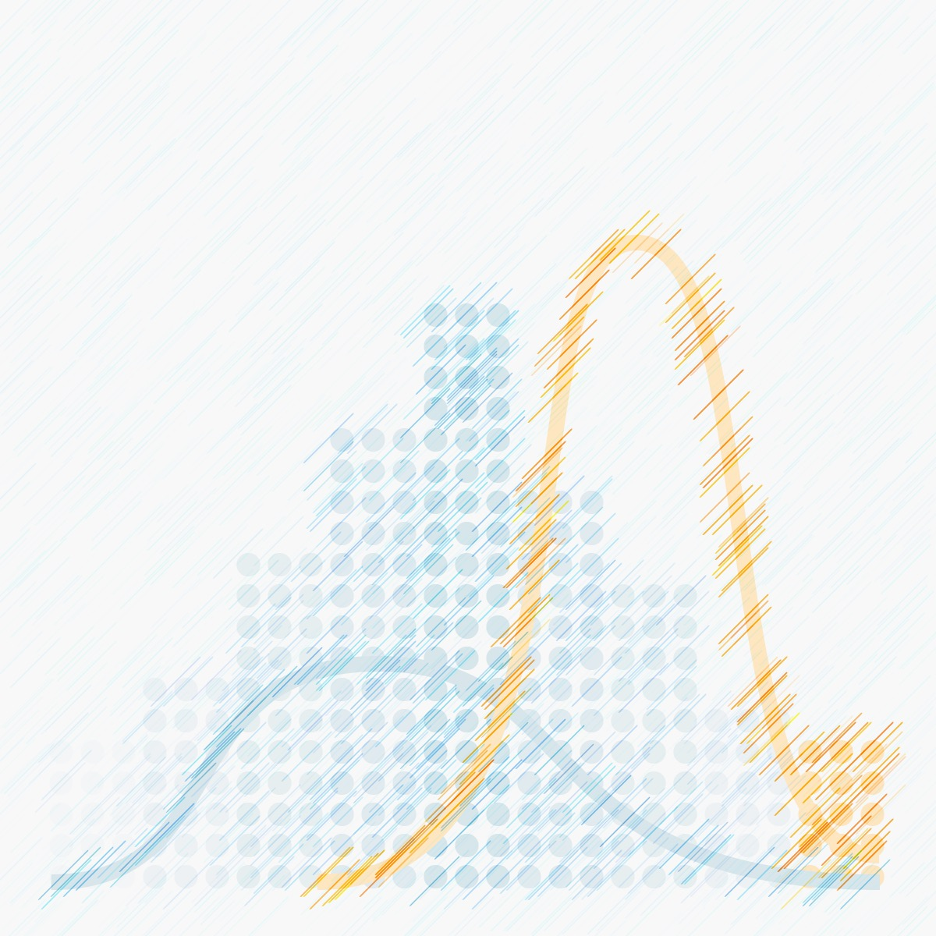
Statistics
A statistic is some sort of summary of the data
The average is a statistic
A frequency (count) is a statistic
Notes:
A statistic provides information about patterns in the data

Slide 8
The Vocabulary of Statistics
Population
Sample
Notes:
Population is any group (all individuals/things included) that share a set of characteristics (pg. 7)
Things about the population are often unknown (e.g., how many people have depression?)
Usually not possible to collect data on the entire population
Sample is a subset of the population
The purpose of any sample is to represent the population from which it came (pg. 5)
Examples of Both

Slide 9
The Vocabulary of Statistics
Descriptive Statistics
Describing the data that you have (your sample)
Inferential Statistics
Understanding what your data say about the population
Notes:
Descriptive statistics describe your data
Inferential statistics allow you to infer about the population
These will make more sense as we discuss more vocabulary and think about examples

Slide 10
The Vocabulary of Statistics
Independent Variables
Dependent
Variables
“predictors” or “IV”
These are the variables that we think are causing or influencing the outcome
“outcomes” or “DV”
These are the variables that we think are caused by an independent variable

Slide 11
The Vocabulary of Statistics
Hypothesis Testing (Inferential Statistics)
“Null Hypothesis Significance Testing”
Gives us an idea about what the population may look like based on our sample (accounts for sampling error) = “significance”

Slide 12
The Vocabulary of Statistics
Hypothesis Testing (Inferential Statistics)
“Null Hypothesis Significance Testing”
Effect Sizes
“Magnitude of the effect”
Tells us how big the effect is = “meaningfulness”
Notes:
Both NHST (null hypothesis significance testing) and effect sizes work together to tell a more complete story

Slide 13
Scales of Measurement
"The way a variable is measured determines the kinds of statistical procedures that can be used” (pg 10)
Want measures that:
1. Are reliable
2. Are valid
3. Are meaningful
4. Have a high degree of information
Notes:
Reliable means it is precise (it is consistently good at measuring what you are measuring)
Valid means it measures what we think it is measuring (pounds are measuring weight)
Meaningful means it is in units that are meaningful to others
A high degree of information means that the measure captures the important facets of the thing you are measuring
measuring age based on “old” or “young” doesn’t have as much information as measuring the actual age in years

Slide 14
Scales of Measurement
4 General Types (see pg. 11)
Scale | Definition | What the scale allows you to do
Nominal | Categories based on qualitative similarity (no order to the categories) | Count the number of things in the categories
Ordinal | Like nominal, but the categories can be ranked | Count and rank the number of things in each category
Interval | Quantify how much of something | Count, rank, and quantify how much of something there is (zero does not mean there’s nothing)
Ratio | Quantify how much of something (zero means there is none of that thing) | Count, rank, and quantify how much of something there is with a meaningful zero

Slide 15
Scales of Measurement
4 General Types (see pg. 11)
Scale | Definition | What the scale allows you to do
Nominal | Categories based on qualitative similarity (no order to the categories) | Count the number of things in the categories
Ordinal | Like nominal, but the categories can be ranked | Count and rank the number of things in each category
Interval | Quantify how much of something | Count, rank, and quantify how much of something there is (zero does not mean there’s nothing)
Ratio | Quantify how much of something (zero means there is none of that thing) | Count, rank, and quantify how much of something there is with a meaningful zero

Slide 16
Scales of Measurement
4 General Types (see pg. 11)
Scale | Definition | What the scale allows you to do
Nominal | Categories based on qualitative similarity (no order to the categories) | Count the number of things in the categories
Ordinal | Like nominal, but the categories can be ranked | Count and rank the number of things in each category
Interval | Quantify how much of something | Count, rank, and quantify how much of something there is (zero does not mean there’s nothing)
Ratio | Quantify how much of something (zero means there is none of that thing) | Count, rank, and quantify how much of something there is with a meaningful zero
Increasing degree of information

Slide 17
Scales of Measurement
4 General Types (see pg. 11)
Scale | Definition | What the scale allows you to do
Nominal | Categories based on qualitative similarity (no order to the categories) | Count the number of things in the categories
Ordinal | Like nominal, but the categories can be ranked | Count and rank the number of things in each category
Interval | Quantify how much of something | Count, rank, and quantify how much of something there is (zero does not mean there’s nothing)
Ratio | Quantify how much of something (zero means there is none of that thing) | Count, rank, and quantify how much of something there is with a meaningful zero
Team Challenge:
What are some examples of each type?

Slide 18
Scales of Measurement
These lie on a spectrum from qualitative to quantitative
Nominal Ordinal Interval Ratio
Qualitative Quantitative

Slide 19
Scales of Measurement
Discrete
Continuous
Cannot be broken down into smaller units
Can be broken into smaller units
Number of siblings, racial groups, have the disease or not
Time to finish an exam, height of a person
Notes:
Another way of categorizing variables is by discrete vs. continuous

Slide 20
Break Time

Slide 21
Graphing Data
A VERY IMPORTANT part of data analysis
It is useful for both:
Understanding patterns in the data
Communicating results in a much more meaningful way
Takes some practice
Notes:
My personal favorite aspect of data analysis
Keep an eye out for graphics that are used in your field, when they are used, and how

Slide 22
Some Types of Data Graphics
Each provide different insights into the data
Line Graphs
Bar Graphs and Histograms
Scatterplots
Boxplots

Slide 23
Line Graphs
Generally shows trends and patterns across groups

Slide 24
Bar Graphs and Histograms
These help us understand distributions and frequencies

Slide 25
Bar Graphs and Histograms
These help us understand distributions and frequencies
Skew
Kurtosis
Symmetric vs. Asymmetric
Unimodal vs. Multimodal
Short-tailed vs. long-tailed
Notes:
Distribution is a group of scores (pg 15)
Normal curve (the ”gold standard” distribution)
Postive vs Negative skew
High kurtosis vs low kurtosis

Slide 26
Scatterplots
Show us how two (or more) variables are related

Slide 27
Boxplots
Show us the range and where most values are for a variable (usually across groups)

Slide 28
Frequency Tables
Tables can also be very valuable to understand patterns in the data
Level | Frequency | Percent | Cumulative Percent
A | 10 | 25.0% | 25.0%
B | 5 | 12.5% | 37.5%
C | 20 | 50.0% | 87.5%
D | 5 | 12.5% | 100%

Slide 29
Frequency Tables
Tables can also be very valuable to understand patterns in the data
Level | Frequency | Percent | Cumulative Percent
A | 10 | 25.0% | 25.0%
B | 5 | 12.5% | 37.5%
C | 20 | 50.0% | 87.5%
D | 5 | 12.5% | 100%
What plot could be used to show this information?

Slide 30
Review
Name one thing you liked from Broman et al.
What is a statistic?
What is the difference between a population and a sample?
True or False. Independent variables are also known as outcomes.
Which contain more information: ordinal or ratio variables?

Slide 31
Review
Score | Frequency
1 | 0
2 | 3
3 | 2
4 | 5
5 | 8
6 | 6
7 | 3
8 | 1
9 | 6
10 | 8
What information does a boxplot give us?
What about a scatterplot?
What is the difference between a bar graph and a histogram?
Graph the data from the table:

Slide 32
Let’s jump into
Jamovi
Notes:
Using class data :)

Slide 33
Questions?

Slide 34
Next week:
Statistics terminology (Hypothesis, IV and DV, Measurement, Validity and Reliability, Correlation and Experimentation, Distributions, Central Tendency and Variability)
Chapters 2 and 3 in Book
Start looking for articles

